Slide 1
R-OTE 3.8.2
Updated Release of R-Code Occultation Timing Extractor
Programmed by Robert L. (Bob) Anderson
Presentation by Tony George at the 2014 Bethesda, Maryland
IOTA Conference

Slide 2
R-OTE 3..8.2 is an update to R-OTE 3.1.1 released last year at the IOTA Conference. This presentation will provide information on new features provided in R-OTE 3.8.2. For a review of all the features of 3.8.2 including those incorporated in 3.1.1, see the presentation PowerPoint and presentation recording from the 2013 Conference. These files can be found here: http://www.occultations.org/meetings/NA/2013Meeting/R-OTE%202013%20IOTA%20Conference.pdf http://www.youtube.com/watch?v=rMo0W0lwvnI http://www.youtube.com/watch?v=7urp7WYpzJc

Slide 3
Major Advances Over R-OTE 3.3.1 Released at last year’s Conference
Allows direct reading of Limovie and Tangra files without modification
Allows loading and processing of a secondary light curve for comparison and normalization
Performs time stamp error checking and validation of event frames
Reports all solutions in both readings and date/time format

Slide 4
Major advances (cont.)
Interpolates Tangra blank-cell data to allow complete processing of Tangra files
Automatically subtracts Tangra background values from raw light curve data to allow proper magnitude drop processing
Implements integer-frame or sub-frame timing algorithms based on AIC statistical analysis

Slide 5
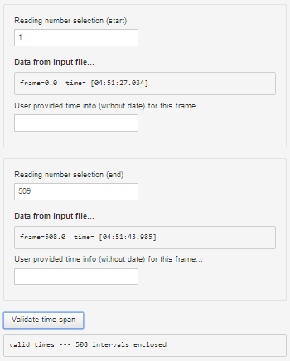
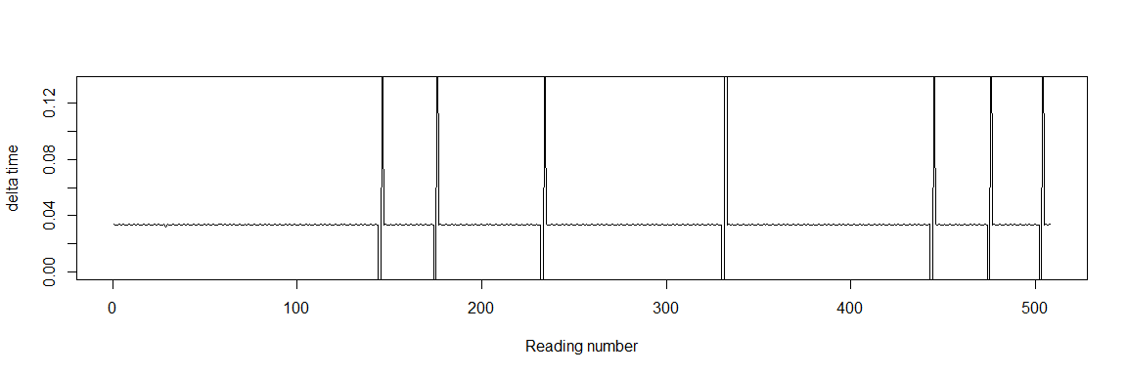
Explanation of Major Advances Performs time stamp error checking and validation of event frames

Slide 6
Explanation of Major Advances Reports all solutions in both readings and date/time format
D (readings) = 51.30 (+0.143/-0.143)
R (readings) = 101.30 (+0.143/-0.143)
D (seconds) = 43.601257 (+0.121/-0.121) @ 2014-06-24 00:00:42.751256
R (seconds) = 86.108388 (+0.121/-0.121) @ 2014-06-24 00:01:25.258388
dur (readings) = 50.01 (+0.202/-0.202)
dur (seconds) = 42.507132 (+0.172/-0.172)

Slide 7
Explanation of Major Advances Interpolates Tangra blank-cell data to allow complete processing of Tangra files
Blank values from Tangra files are interpolated to the closest valid data as shown above.

Slide 8
R-OTE Sub-frame timing discussion
R-OTE uses AIC (Akaike Information Criteria) to determine precisely when it is statistically valid to interpret a D or R transition value as belonging to an intermediate point rather than 'belonging' to the 'baseline' or the 'event'.
Introducing an intermediate point adds an adjustable parameter to the occultation 'model' that is being fitted. The AIC calculation allows the precise determination of when the intermediate point should be selected instead of the simpler model. When this is the case, then the intermediate value can be used in a sub-frame timing calculation, and fractional D and/or R times become possible. (The AIC decision is made independently at each transition).
Integer-frame timing is used when the intermediate point belongs to the baseline or event bottom.
Sub-frame timing is used when AIC testing indicates the intermediate point is between the baseline and event bottom – within the sub-frame timing band [as shown in the next slide]

Slide 9
R-OTE Sub-frame timing discussion
Symmetrical noise: Actual D = 200.5 Measured D = 200.37 +/- 0.35
Asymmetrical noise: Actual D = 200.5 Measured D = 200.57 +/- 0.22

Slide 10
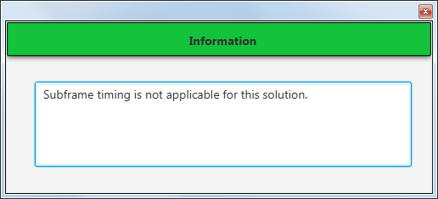
R-OTE Sub-frame timing discussion
Symmetrical noise: Actual D = 200.5 Measured D = 200.00 +1.5/- 0.50

Slide 11
Sub-frame timing discussion -- Summary
Different occultation extraction programs deal with sub-frame timing in different ways:
AOTA – never uses sub-frame timing. Only integer timing is used regardless of the signal-to-noise level. For light curves with high signal-to-noise ratios, AOTA will limit the precision of the occultation timing analysis. The integer timing result will be bracketed by error bars determined from Monte Carlo methods.
Occular – always uses sub-frame timing, even when the signal-to-noise level is too low to warrant the implied precision. Since error bars are determined from Monte Carlo methods, no harm is done, since the ‘over precise’ answer will occur within the error bars.
R-OTE – uses sub-frame time when justified by AIC statistical analysis, and uses integer timing when sub-frame timing is not justified. Error bars are determined by pre-processed tables of Monte Carlo simulations. Error bars can be less than ½ frame duration when sub-frame timing is warranted.

Slide 12
R-OTE 3.8.2 Special features
Gradual-transition-event User selectable confidence intervals supported:
68.3%
90%
95%
99%
Fourier filtering of the following types of light curve interference:
AC voltage interference
Drift scan microlensing cyclic variation
Scintillation (experimental)

Slide 13
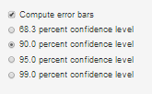
Explanation of Special Features Gradual-transition-event User selectable confidence intervals supported: 68.3% 90% 95% 99%

Slide 14
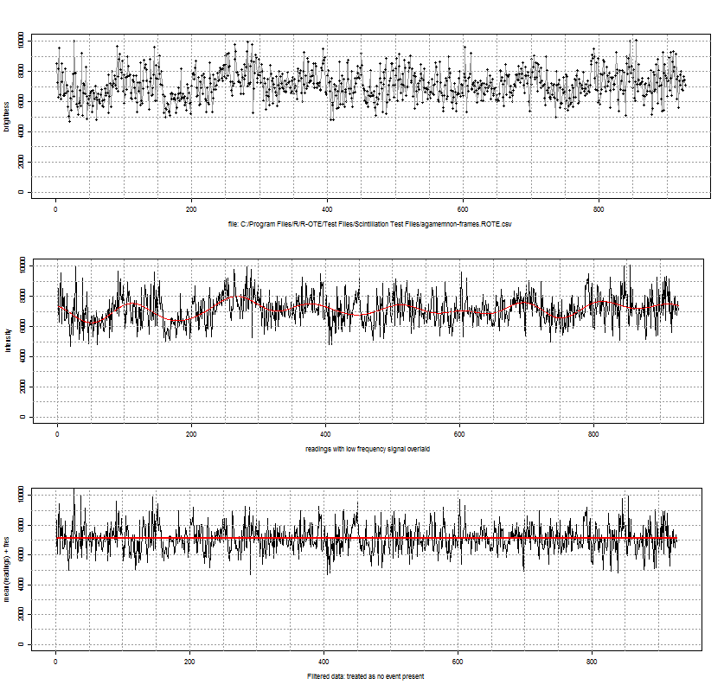
Explanation of Special features Fourier filtering of AC voltage interference

Slide 15
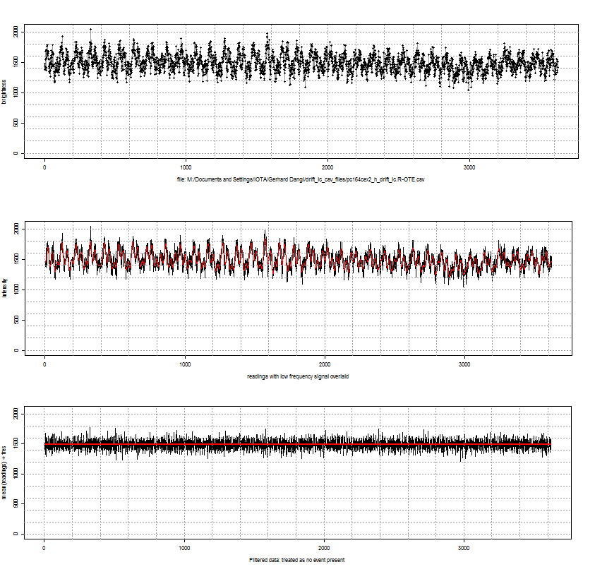
Explanation of Special features Fourier filtering of micro-lensing cyclic variation

Slide 16
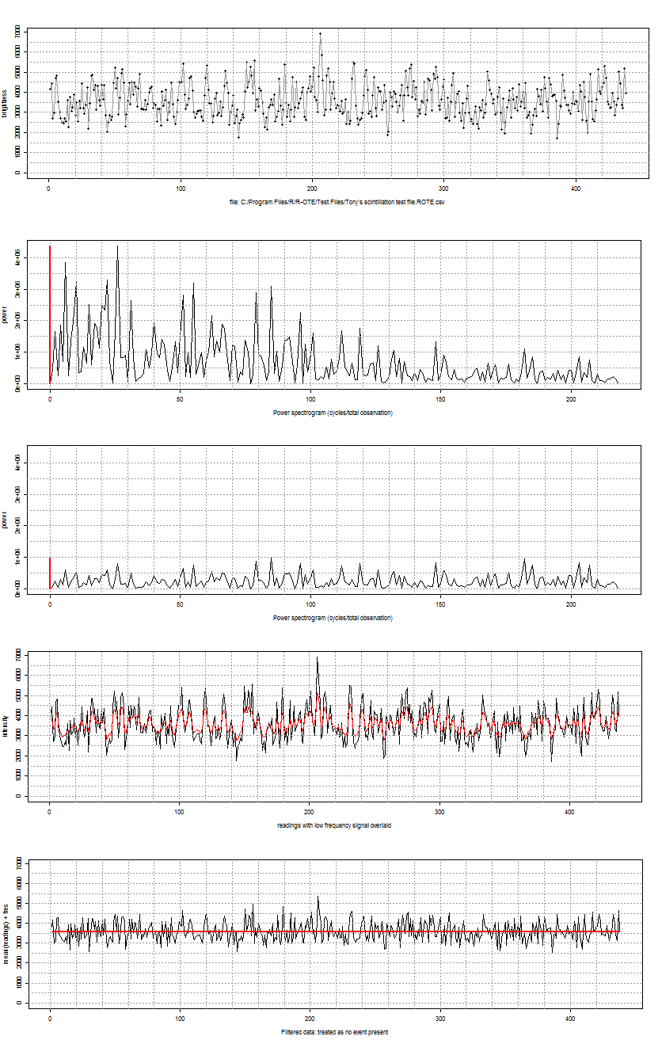
Explanation of Special features Fourier filtering of Scintillation noise (experimental feature)

Slide 17
Who should download R-OTE 3.8.2?
Individuals who have been consistent past users of Occular 4.0 or R-OTE 3.3.1
Experienced observers who collect lots of data with hard to extract low SNR light curves
Software programmers who would like to consider implementing R-OTE approaches into their software.
Other interested IOTA observers who have good technical software skills, who can follow detailed complex instruction manuals, and who have lots of time and lots of patience.

Slide 18
Future work
R-OTE 3.8.2 is the ‘Swiss Army Knife’ of occultation light curve analysis. It contains working versions of all the features that the authors conceived would be helpful. As such, it is complete and likely will not be modified further.
The author, Bob Anderson, is working on a Java program that will look and feel more like Occular, but implement many of the features pioneered in R-OTE 3.8.2. It will have a much improved GUI, much faster operating speed, and the ability to be downloaded across a variety of operating system platforms.
The tentative name given to this new package is Jocular (Java-Occular). Watch for this version to be released sometime in the next year.

